Slide 1






Lecture 10:
Timers in JavaScript
Course - Web Development - II
-By
Instructor Name
‹#›
welcome@krmangalam.edu.in
Sohna Road,Gurugram,Haryana 122103

Slide 2

| Table of Contents
setTimeOut() and setTimeInterval()
References.
The End.
‹#›

Slide 3
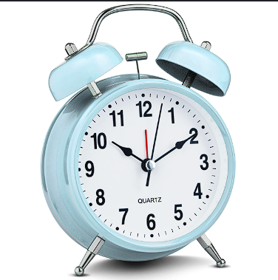
| Have you ever wondered how an alarm clock works?
You set an alarm for 6:00 AM.
How does the alarm know when to ring exactly at 6?
An alarm doesn’t do anything right now.
It just waits quietly in the background.
When the time is up — RINGGG! — it does its job!
That’s exactly what setTimeout() does in JavaScript.
‹#›

Slide 4
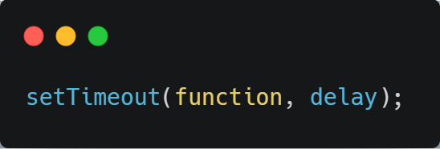
| setTimeout
setTimeout() is a JavaScript function that waits for a certain amount of time and then runs a task.
It’s like telling JavaScript:
Wait for some time… then do this.
Just like setting an alarm — it doesn’t ring now, it rings after a delay.
function – The code you want to run later
delay – Time to wait in milliseconds
‹#›

Slide 5
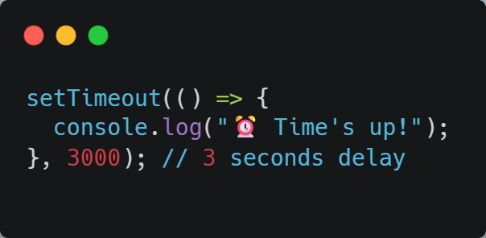
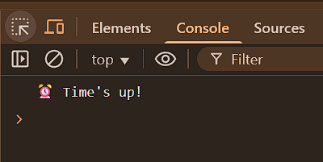
| setTimeout
‹#›

Slide 6

| Coding Questions
1. Simple setTimeout
Task : Write a script that first logs the message "First message" to the console. Then, use setTimeout
to log the message "Second message (after 2 seconds)" to the console after a 2-second delay.
Finally, log "Third message" to the console immediately after setting the timeout.
‹#›

Slide 7
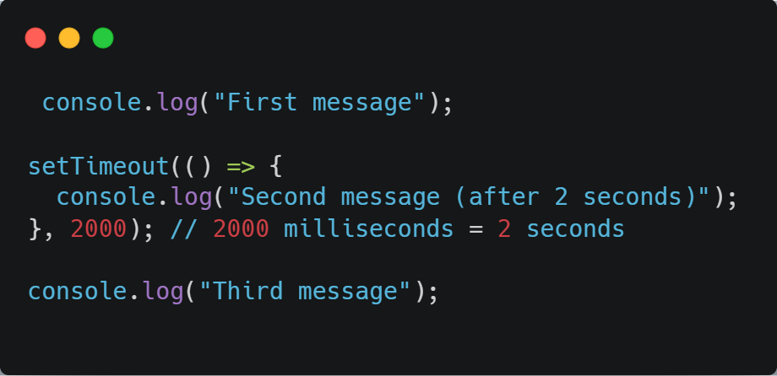
| Coding Questions
Solution :
‹#›

Slide 8
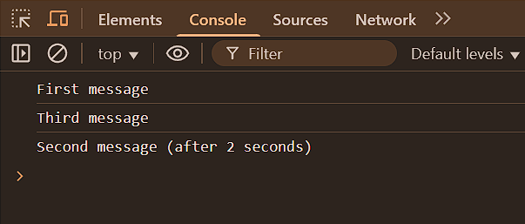
| Coding Questions
Output :
‹#›

Slide 9
| Have you ever wondered how we make code repeat again and again after some time?
Imagine a clock on your wall. Every second, the time changes.
But no one is pressing a button. It updates by itself — again and again!
That’s what we want in code!
So how do we tell JavaScript: Repeat this code every 1 second… again… and again… and again…’?
The answer is: setInterval()
‹#›

Slide 10
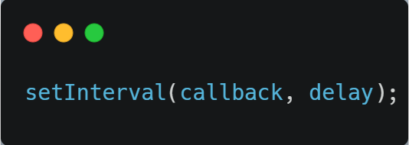
| setInterval
setInterval() is a built-in JavaScript function used to repeatedly execute a specified function or block of code at fixed time intervals (in milliseconds).
callback → The function to execute repeatedly
delay → Time between each execution
‹#›

Slide 11
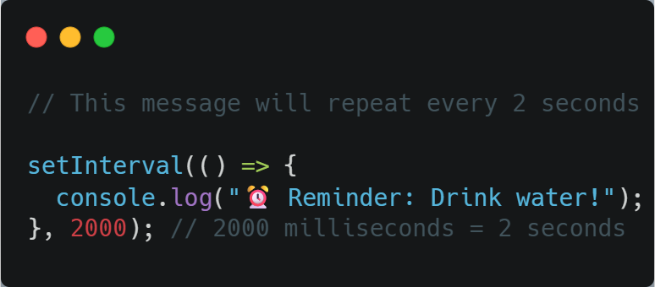
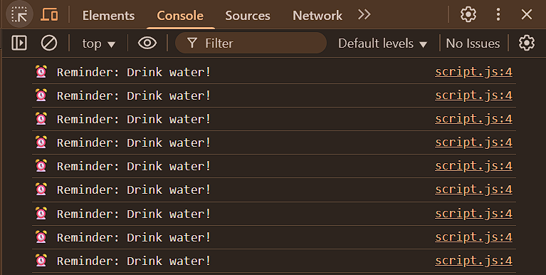
| setInterval
‹#›

Slide 12
| Coding Questions
2. Simple setInterval
Task : Write a script that uses setInterval to log the message "Repeating message" to
the console every 2 seconds. Let it run a few times before you manually stop
the script execution.
‹#›

Slide 13
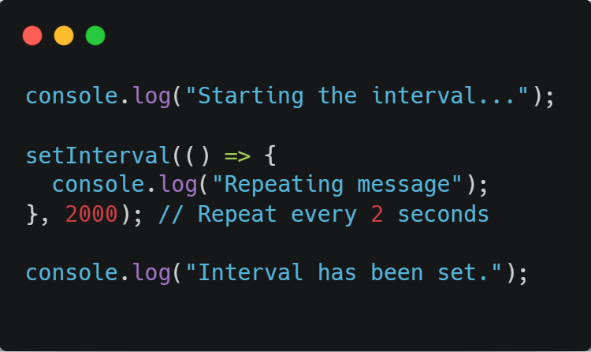
| Coding Questions
Solution :
‹#›

Slide 14
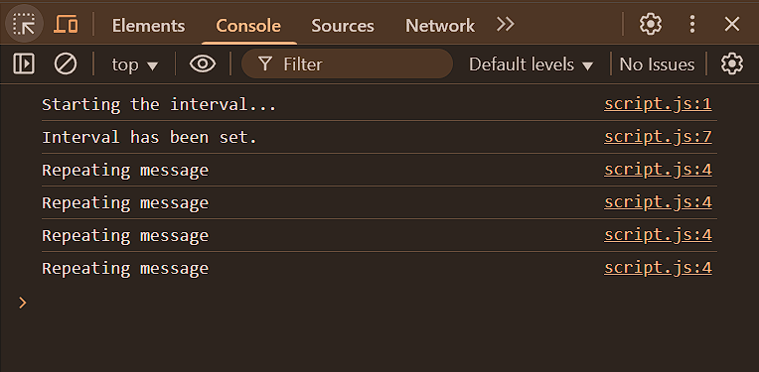
| Coding Questions
Output :
‹#›

Slide 15
| Check Your Understanding
Question : Which function schedules a callback to be executed once after a specified delay?
Options : a) setInterval()
b) runAfter()
c) setTimeout()
d) delay()
Answer : c) setTimeout()
Explanation:
setTimeout is a built-in browser API that allows you to schedule a single execution of a function after a given time has elapsed.
‹#›

Slide 16
| Check Your Understanding
Question : In the code setTimeout(myFunction, 3000);, what does the number 3000 represent?
Options : a) The number of times the function will run.
b) The priority of the task.
c) The delay in seconds (3000s).
d) The delay in milliseconds (3s).
Answer : d) The delay in milliseconds (3s).
Explanation:
The second argument for setTimeout and setInterval is the delay time measured in milliseconds. 1000ms = 1 second.
‹#›

Slide 17
| Check Your Understanding
Question : If you schedule a setTimeout with a 0ms delay, when will its callback function execute?
Options : a) Immediately, before any other code.
b) It will never execute.
c) After the current synchronous code in the call stack has finished executing.
d) Exactly at the same time as the next line of code.
Answer : c) After the current synchronous code in the call stack has finished executing.
Explanation:
setTimeout(fn, 0) doesn't execute the function immediately. Instead, it places the function in the callback queue to be run at the earliest opportunity, which is right after the currently executing synchronous code block is finished.
‹#›

Slide 18
| References
MDN Web Docs : Comprehensive and official documentation for JS. 🔗https://developer.mozilla.org/en-US/docs/Web/JavaScript
W3Schools – JS Tutorial : Beginner-friendly JS tutorials with examples and interactive editors. 🔗 https://www.w3schools.com/js/
JavaScript.info - A comprehensive tutorial-style website that covers core JavaScript concepts in depth.
🔗https://javascript.info/
‹#›

Slide 19
Thanks
For
Watching
Course - Web Development - II
‹#›
welcome@krmangalam.edu.in
Sohna Road,Gurugram,Haryana 122103

